Slide 1
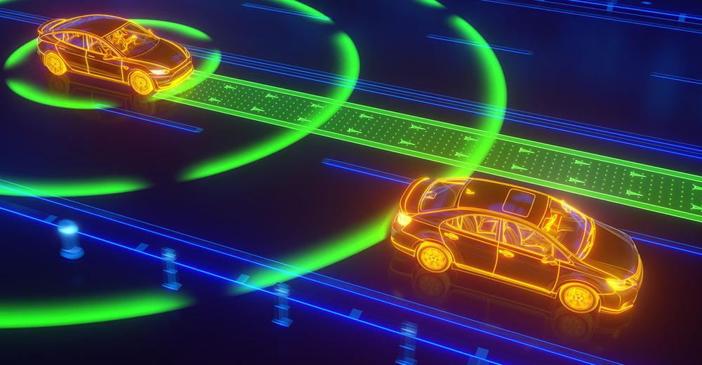
Autonomous Vehicles Simulation Testing
Group Number #1 (CMPE 287)
Huyen Nguyen | Prit Lakhani || Richard Ngo | Sudha Vijayakumar

Slide 2


Overview
Introduction
Testing Approach & Challenges
Scenario-based Testing Requirements
LGSVL Simulator
Autonomous Driving Architecture
Apollo
AI Testing Tool
Test Scenarios
Classification Trees
3D Table
Demo
Conclusion
Notes:
huyen

Slide 3
Introduction
Autonomous Vehicle (AV) Simulation Testing:
Is a software or system that tests autonomous vehicles in different domains and situations
Three different approaches: End-to-End Stimulation, Replay Stimulation, and Planning Stimulation
Project objectives
Scenario-Based Testing Approach with different test cases
Analyze test models and complexity
Notes:
One of the ways to test AV is using simulation testing. Simulation testing allows engineers to test in a wide range of scenarios. Engineers can modify the code after every scenario for better results and improve models without having to physically deploy real cars into the real world. There are different approaches of simulation testing include:
End-to-End Simulation: engineers have the ability to generate the entire AV synthetically.
Replay Simulation: can simulate real-world state. Engineers can modify the code to be more effective and behave well in the real world scenario.
Planning Simulation: AV system is not aware that it is in simulation and should know most things in the real world. This simulation allows engineers to observe how the model interacts with the assertion.

Slide 4
Testing Approach & Challenges
LGSVL Simulator - an open-source code from LG Electronics America R&D Lab to provide a simulator for developers to test AV algorithms.
LGSVL currently has integration with Autoware.auto and Apollo platforms to generate maps, weathers etc
5 major challenges are “drive out of the lanes, complex requirements, non-deterministic algorithms, inductive learning algorithms, and fail-operational systems”
Notes:
One of the ways to test AV is using simulation testing. Simulation testing allows engineers to test in a wide range of scenarios. Engineers can modify the code after every scenario for better results and improve models without having to physically deploy real cars into the real world. There are different approaches of simulation testing include:
End-to-End Simulation: engineers have the ability to generate the entire AV synthetically.
Replay Simulation: can simulate real-world state. Engineers can modify the code to be more effective and behave well in the real world scenario.
Planning Simulation: AV system is not aware that it is in simulation and should know most things in the real world. This simulation allows engineers to observe how the model interacts with the assertion.

Slide 5



Scenario-based Testing Requirements
Python
At least 4 GHz Quad core CPU
NVIDIA GTX 1080 (8GB memory) or higher
Ubuntu 18.04 (64-bit) or Ubuntu 20.04 (64-bit)

Slide 6
Runtime
Python
Intel Xeon E3-1200 8 core
NVIDIA GTX 2080 Super w/ 8GB
Ubuntu 20.04 (64-bit)

Slide 7
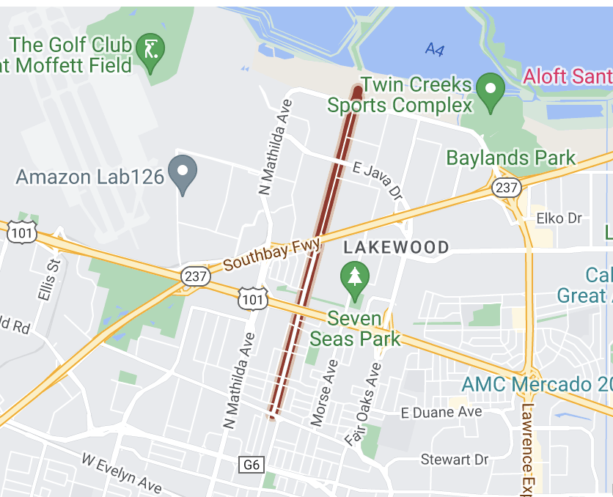

Project resources
AI Testing tool
LGSVL Simulator
Apollo 6.0
Python API
Borregas Avenue Map

Slide 8
Challenges/ Known issues
GPU locked
Issue: Cannot access GPU
Cause: Apollo docker container fills up logs over 400GB
Fix: Clear the cache frequently. Stop apollo container after usage.
Apollo 6.0 Build error
Issue: Apollo build fails
Cause: Bazel version error
Fix: https://githubhot.com/repo/ApolloAuto/apollo/issues/14374
Apollo 6.0 Map limitation for LGSVL simulator
Issue: Only Borregas Avenue supported with 2 destination points.
Cause: limited scope
Potential fix: https://github.com/lgsvl/simulator/issues/1430 => Didn’t work!! San-Francisco map is misaligned in the Apollo 6.0 view.

Slide 9
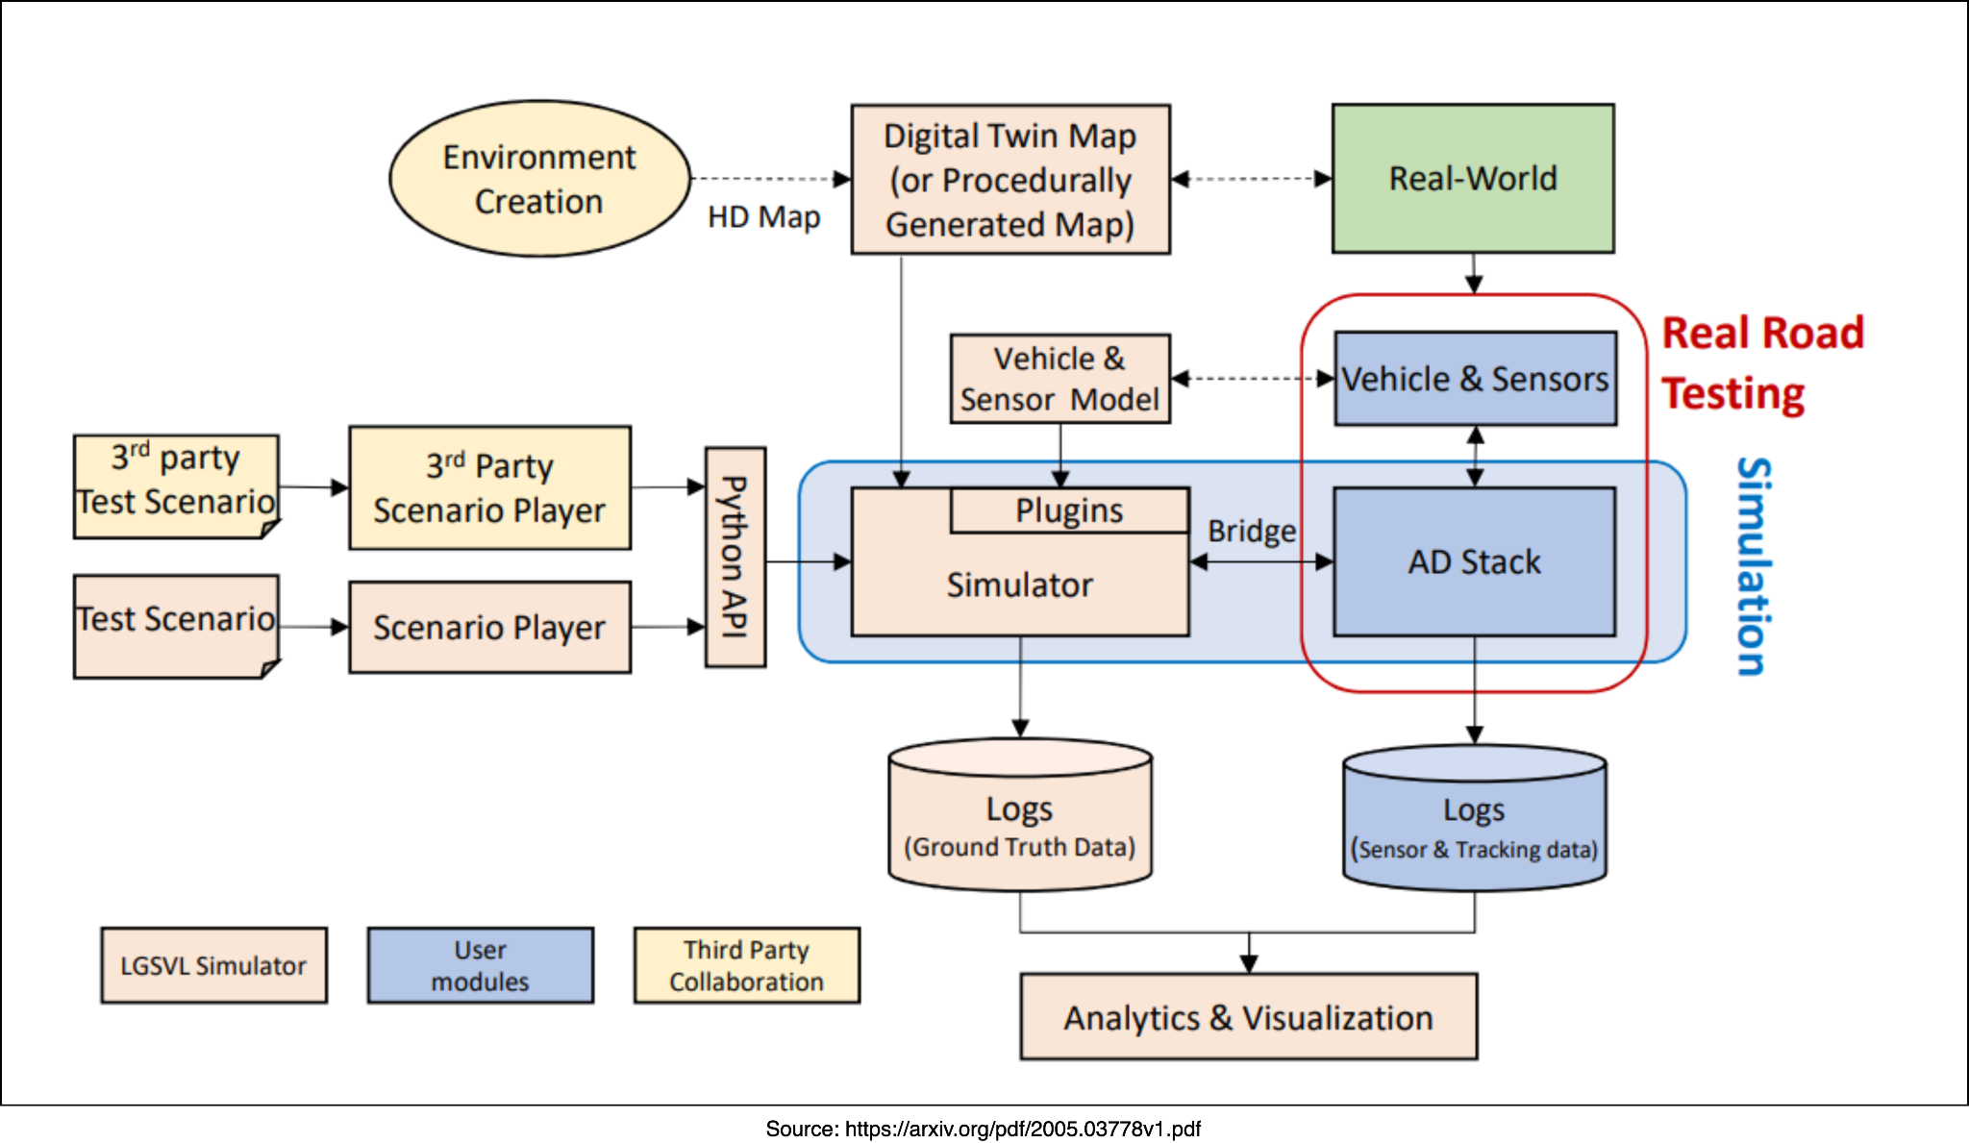
LGSVL Simulator
LGSVL Simulator : A simulation tool that uses Unity game engine.
System Requirements:
~4 GHz, Quad-core, 16+ GB of RAM
Nvidia GTX-1070/1080 Nvidia RTX-2070/2080
Nvidia RTX-3060+
8+ GB of GPU
Windows 10 or Linux (Ubuntu 18.04/20.04)
Notes:
Prit

Slide 10
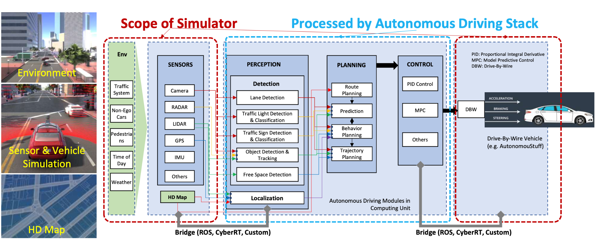
Autonomous Driving Architecture
Figure 02: High-level architecture of autonomous driving system and the role of the simulation engine

Slide 11
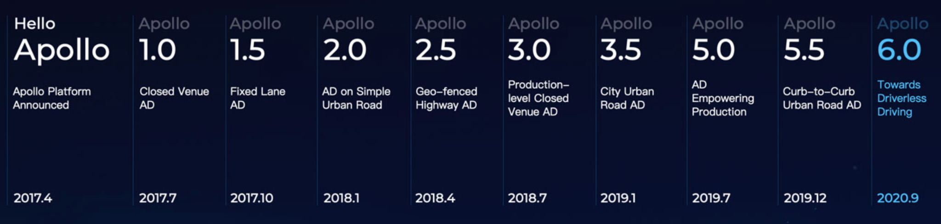

Apollo ~ A road towards driverless technology
Developed by
High performance, flexible architecture which accelerates
Development
Testing
Deployment
open Autonomous driving platform
Powerful deep learning models for,
Perception
Prediction
Planning
Notes:
Sudha
Deep learning models,
Pointpillar models for obj detection from LiDAR points cloud data optimized by tensorRT
Semantic map based pedes prediction model to better fit pedes behav in env
Learning-based trajectory planning model to imitate driver behaviours in side-passing slow-moving obstacles.

Slide 12
Apollo ~ A road towards driverless technology
Teleoperation with DreamView Integration
Custom audio/ video and network module integration
Audio-based emergency vehicle detection
Upgraded dev environment
C++
Python 3.6
Bszel 3.4
GCC 7.5
PCL TensorTR, PyTorch
New data pipelines
Cloud integrations
Vehicle dynamic model training
Semantic map-based low-speed obstacle prediction
Point-pillar based obstacle detection
Notes:
Sudha

Slide 13
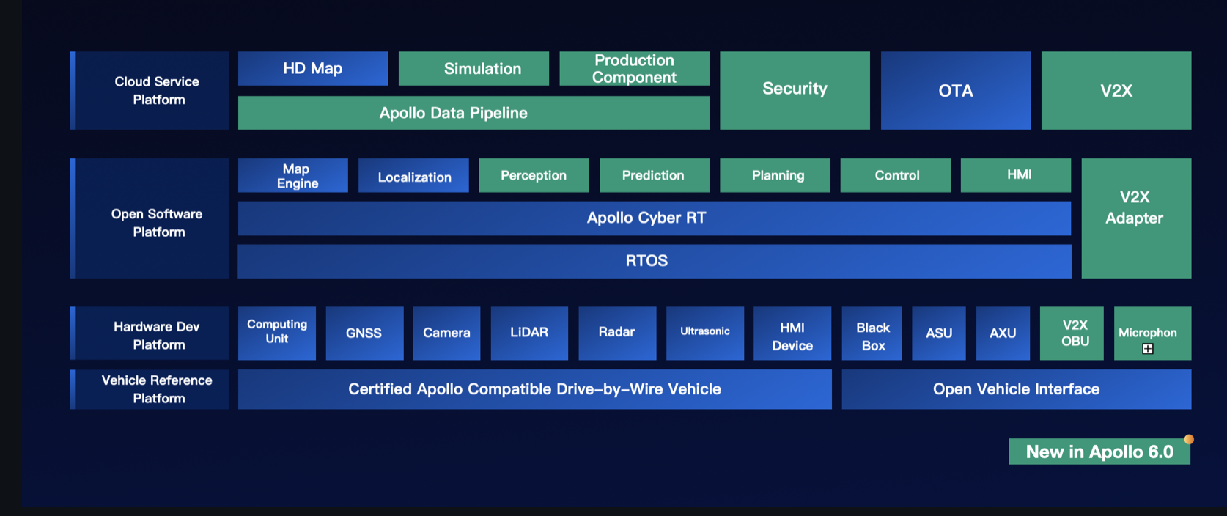
Apollo 6.0 Architecture Overview
Figure 03: Apollo 6.0 Overview
Notes:
V2X - vehicle to everything technology can map object level perception information
Apollo Cyber RT is an open source, high performance runtime framework designed specifically for autonomous driving scenarios.
Automotive security refers to the branch of computer security focused on the cyber risks related to the automotive context.
RTOS - real-time operating system
Over-the-air (OTA) car updates -> sending software updates over internet
LiDAR - Light Detection and Ranging, is a remote sensing method that uses light in the form of a pulsed laser to measure ranges (variable distances) to the Earth.
In most autonomous vehicles, the combination of cameras, LiDAR, and RADAR form the primary set of sensors that provide imaging, detection, ranging, tracking, and sensing of the drive location for a seamless ride.
OpenXC is a hardware and software API for automobiles developed by Ford Bug Labs and proposed as an open standard. At this time, the API is read-only (unlike the OBDII interface) and provides a small number of vehicle measurement parameters only (Engine speed, Vehicle speed, GPS position etc.).

Slide 14
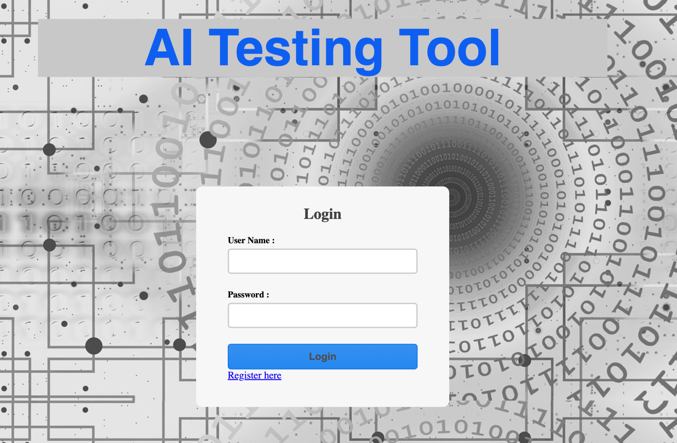
Link: http://aitest-env.eba-mnz322b9.us-east-2.elasticbeanstalk.com
Used to generate:
Context Classification Tree
Input Classification Tree
Output Classification Tree
Decision Table
Test Cases
Notes:
Richard

Slide 15
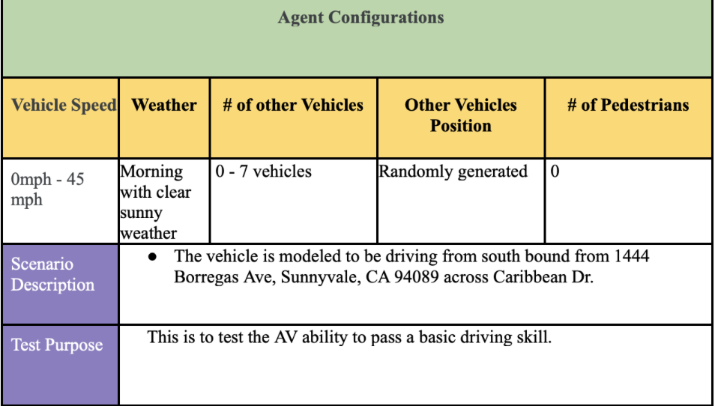
Test Scenarios #1
Drive across the traffic light intersection.
Scenario Description:
The vehicle is modeled to be driving from south bound from 1444 Borregas Ave, Sunnyvale, CA 94089 across Caribbean Dr.

Slide 16
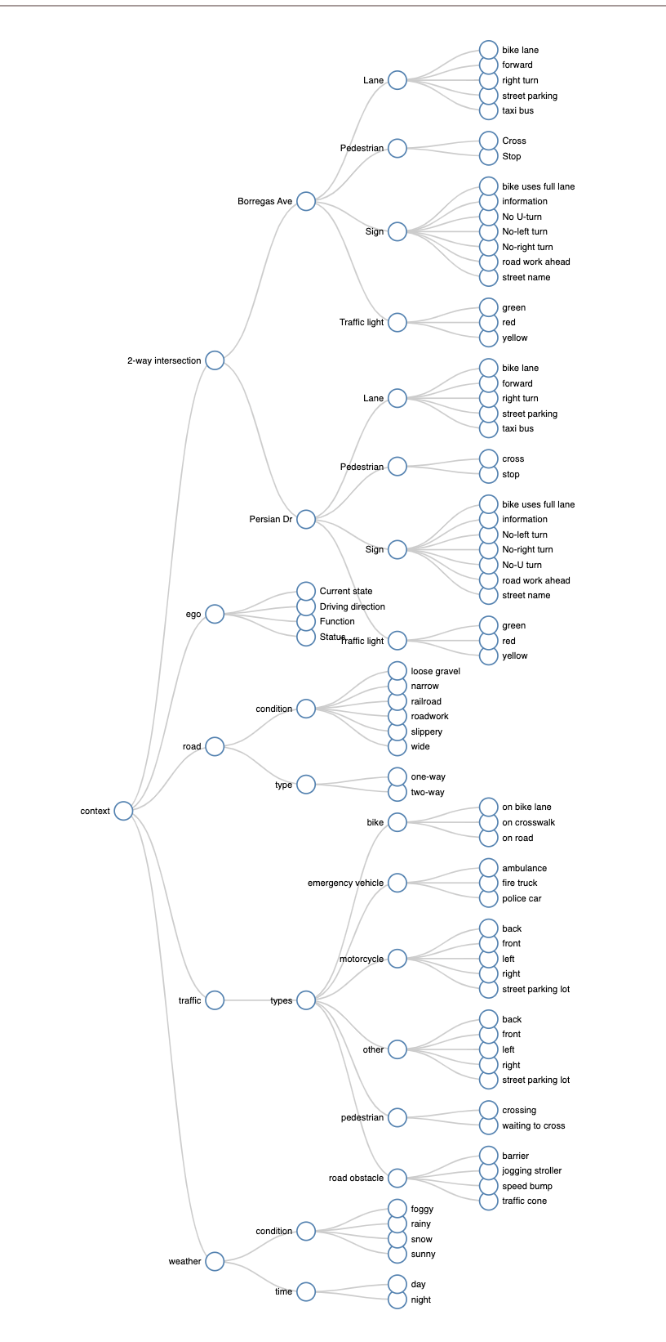
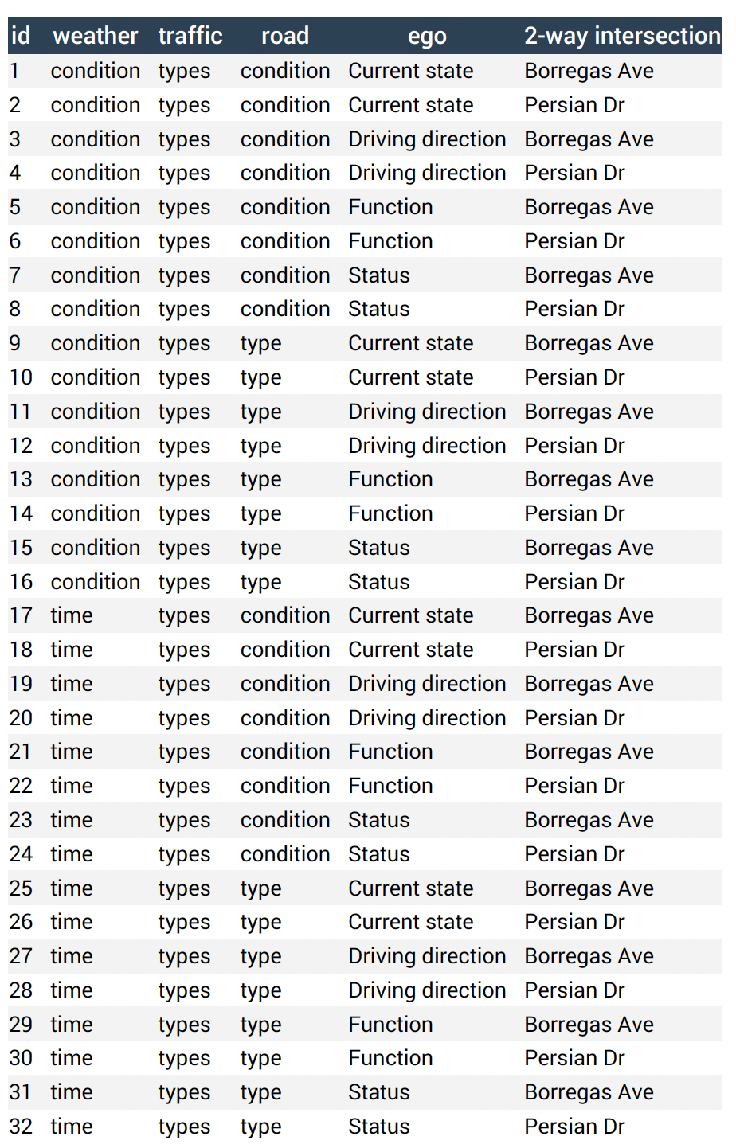
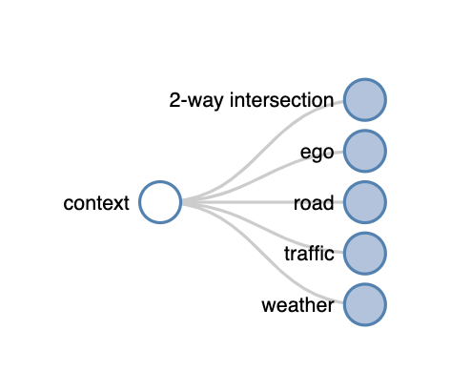
Testing Scenario #1 - Context Modeling

Slide 17
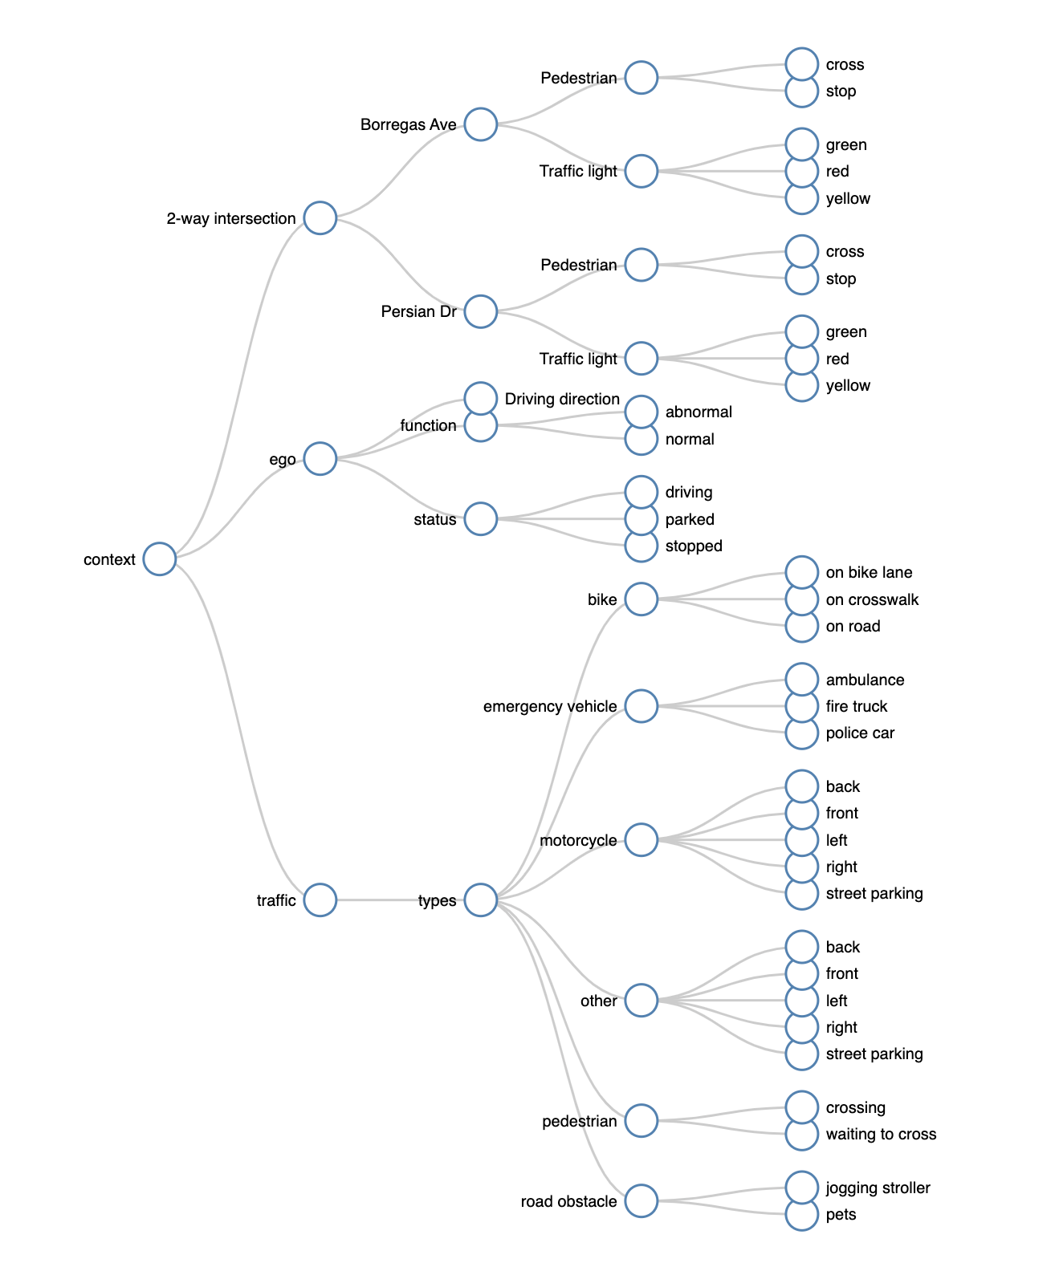
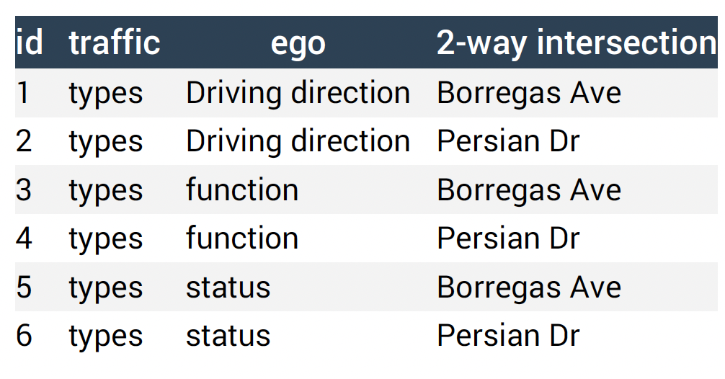
Testing Scenario #1 - Input Classification

Slide 18
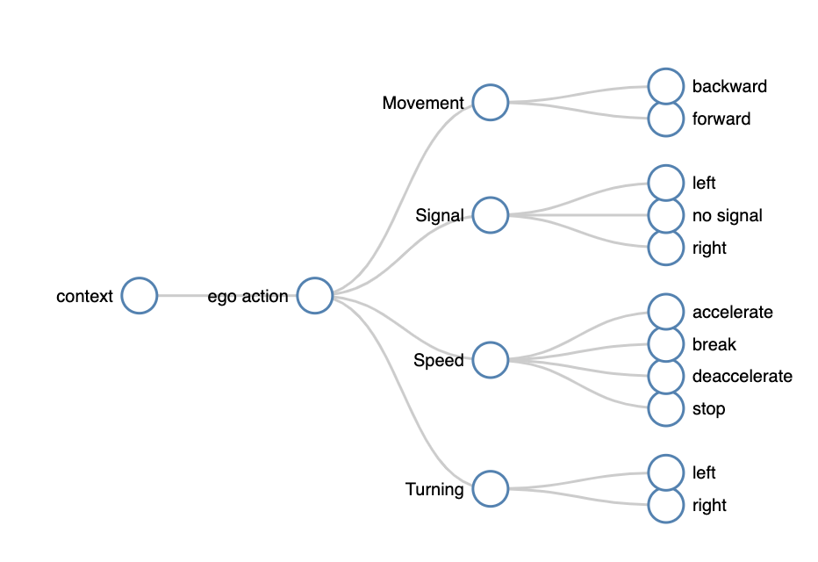
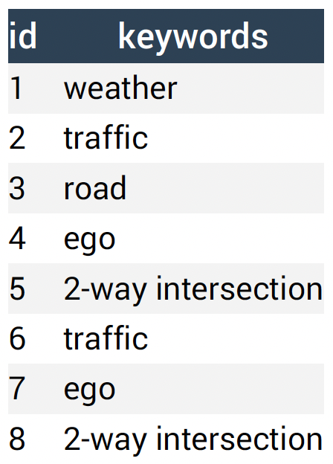
Testing Scenario #1 - Output Classification

Slide 19
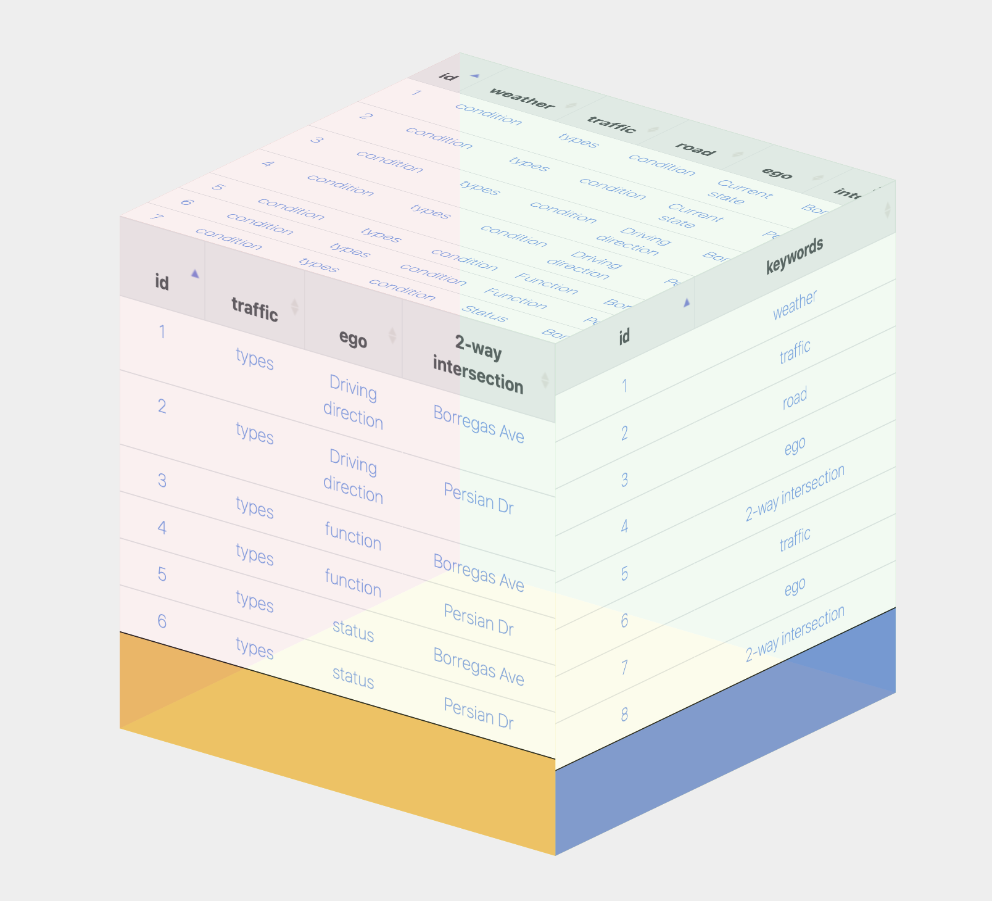
Testing Scenario #1 - Decision Table

Slide 20
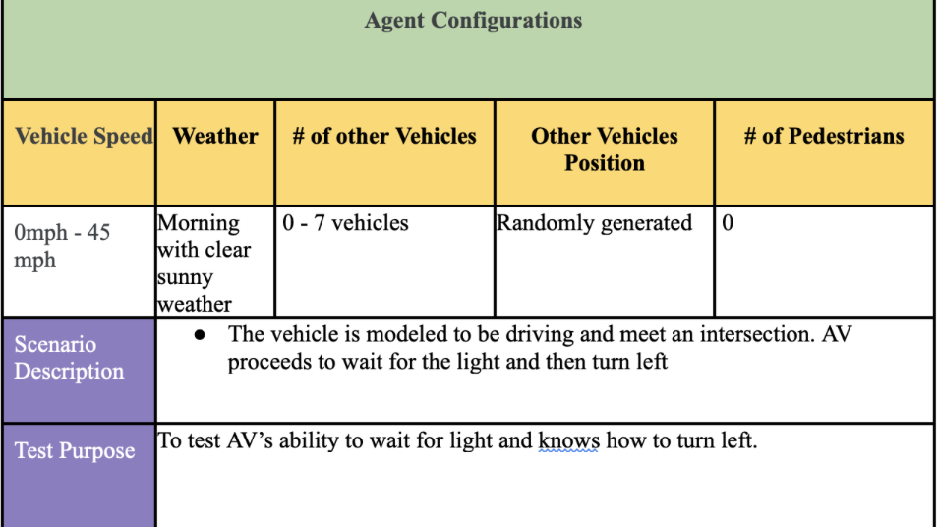
Test Scenarios #2
Drive across 1 intersection and make a left turn
Scenario Description:
The vehicle is modeled to be driving and meet an intersection. AV proceeds to wait for the light and then turn left

Slide 21
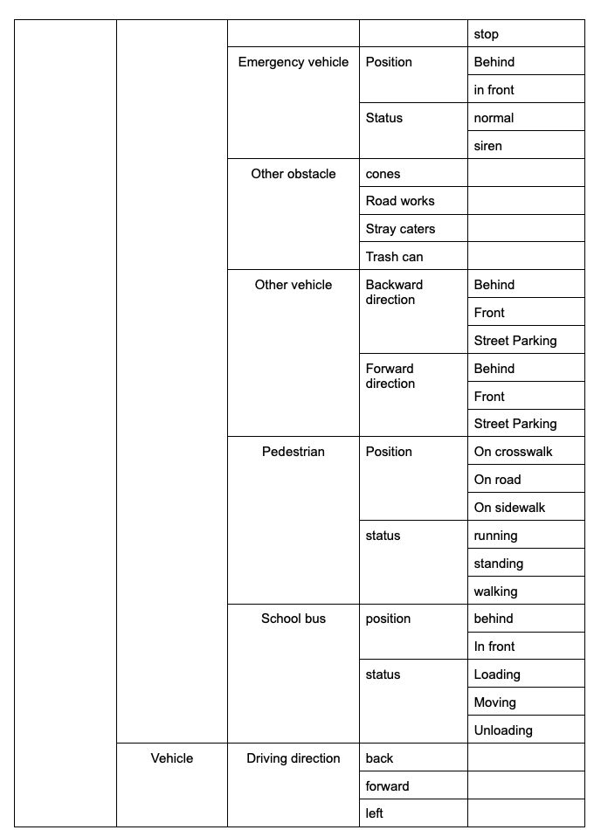
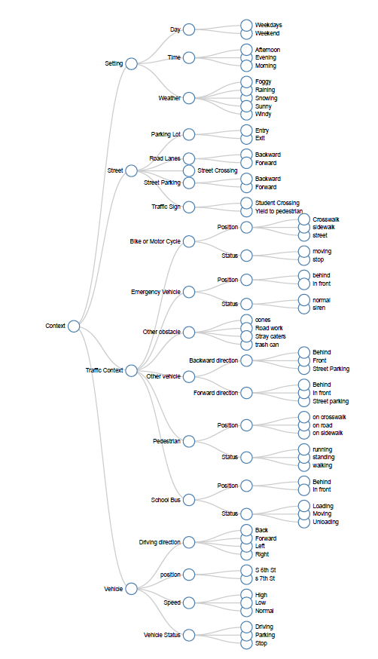
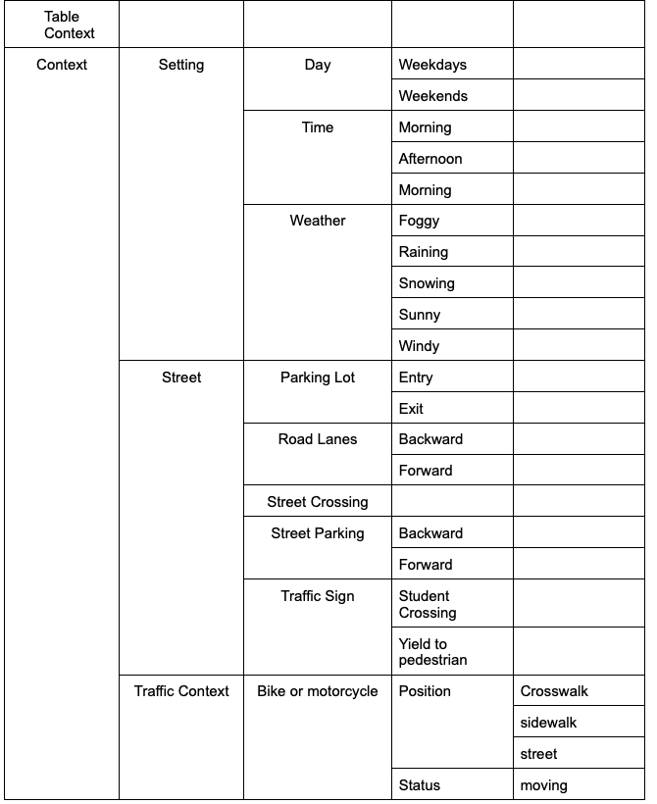
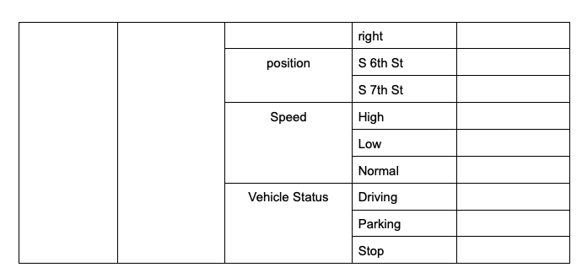
Testing Scenario #2 - Context Modeling

Slide 22
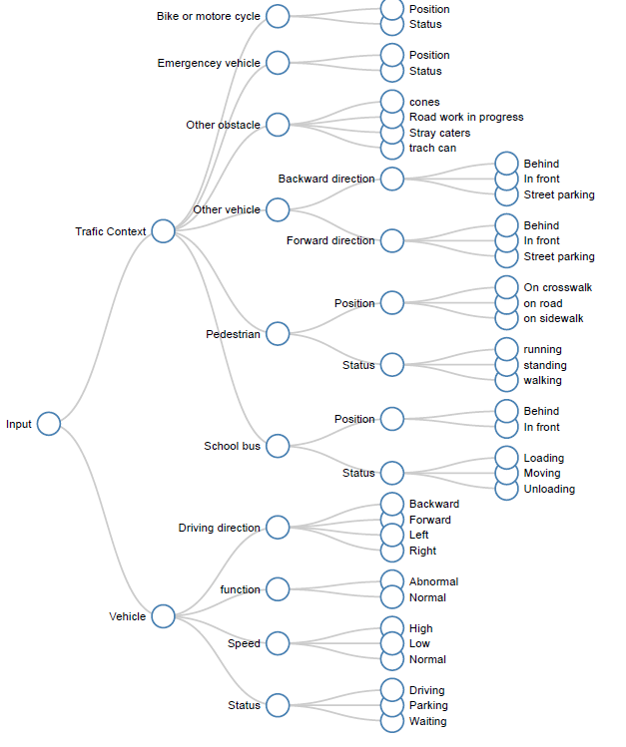
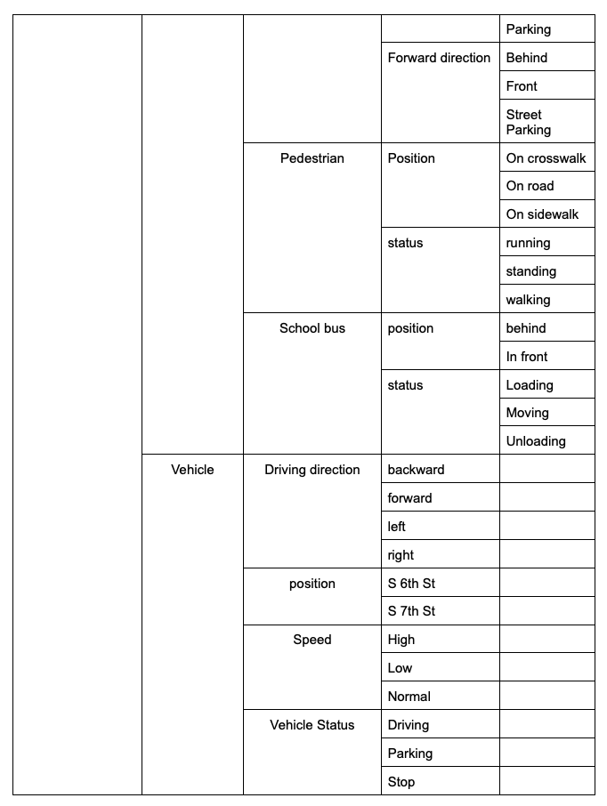
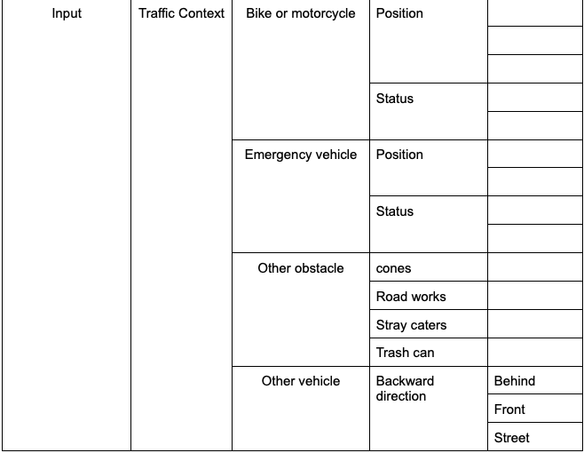
Testing Scenario #2 - Input Classification

Slide 23
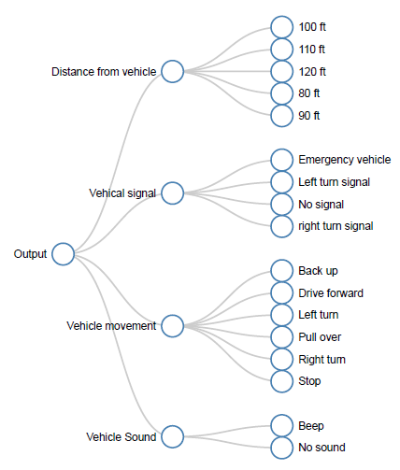
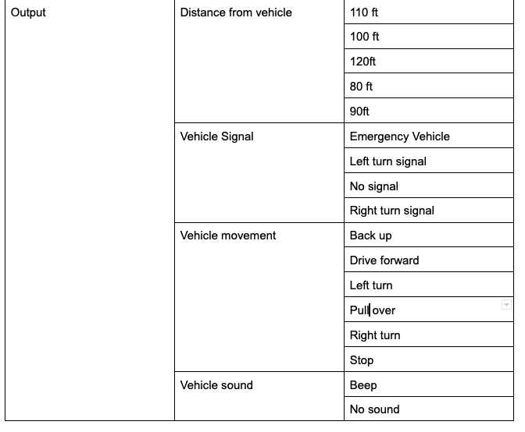
Testing Scenario #2 - Output Classification

Slide 24
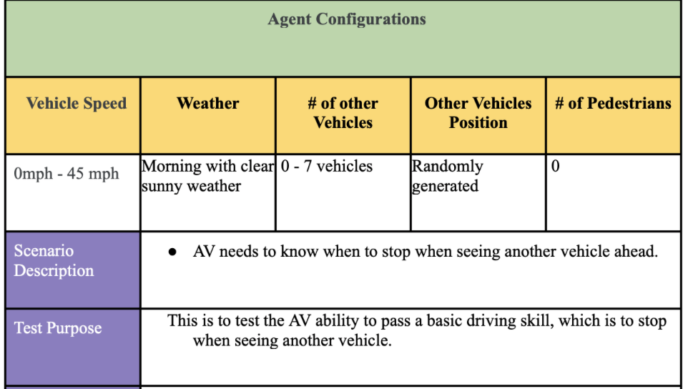
Test Scenarios #3
Collision and Emergency Braking Test
Scenario Description:
AV needs to know when to stop when seeing another vehicle ahead.

Slide 25
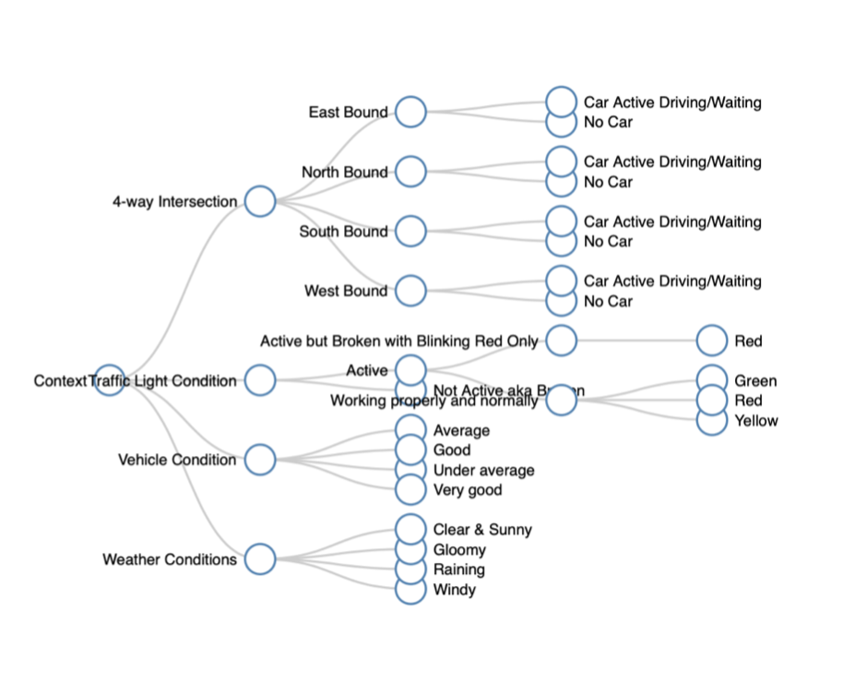
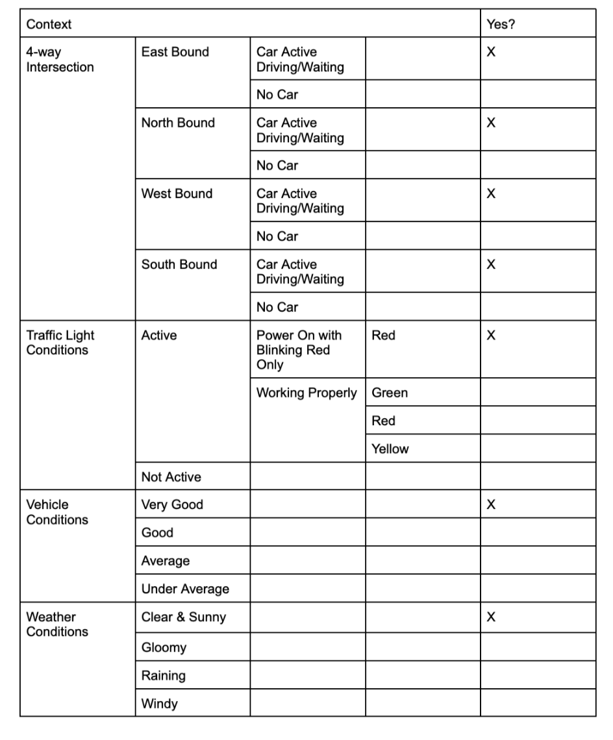
Testing Scenario #3 - Context Modeling

Slide 26
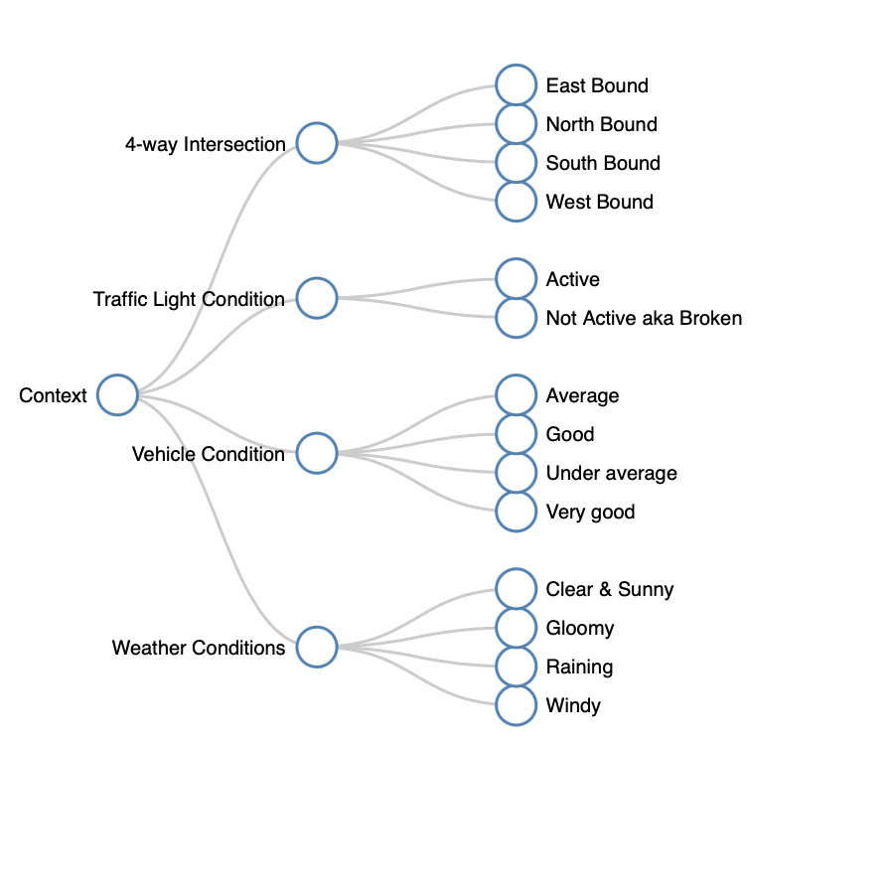
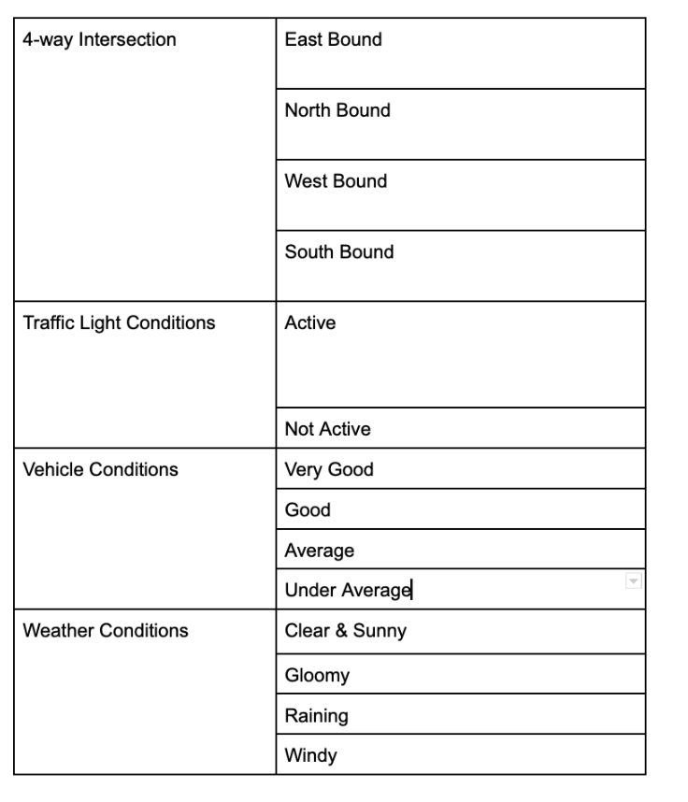
Testing Scenario #3 - Input Classification

Slide 27
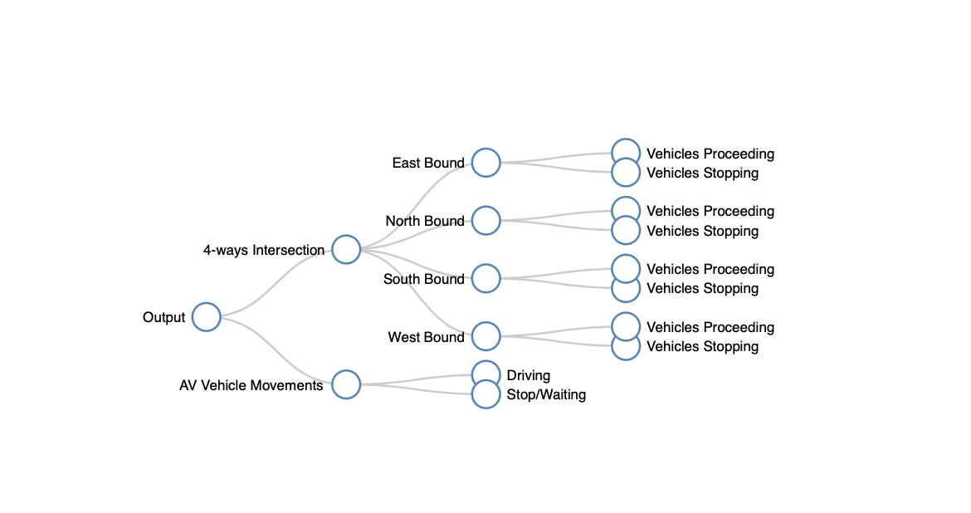
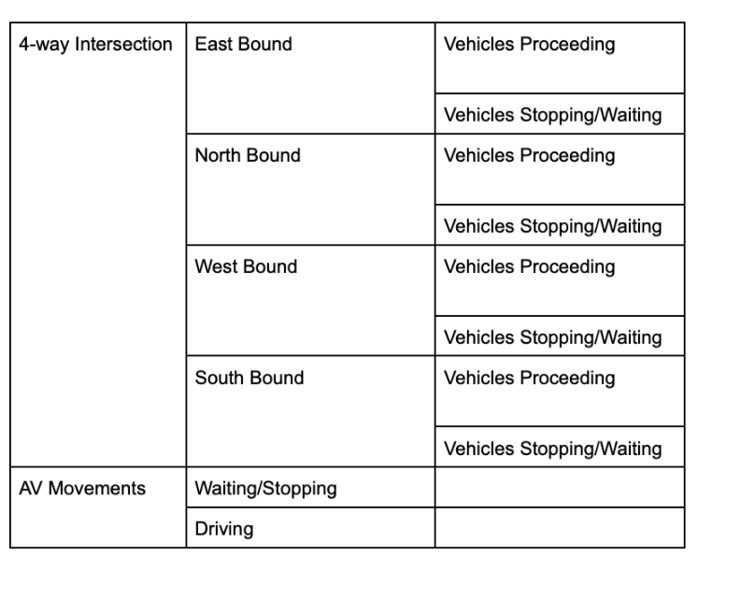
Testing Scenario #3 - Output Classification

Slide 28
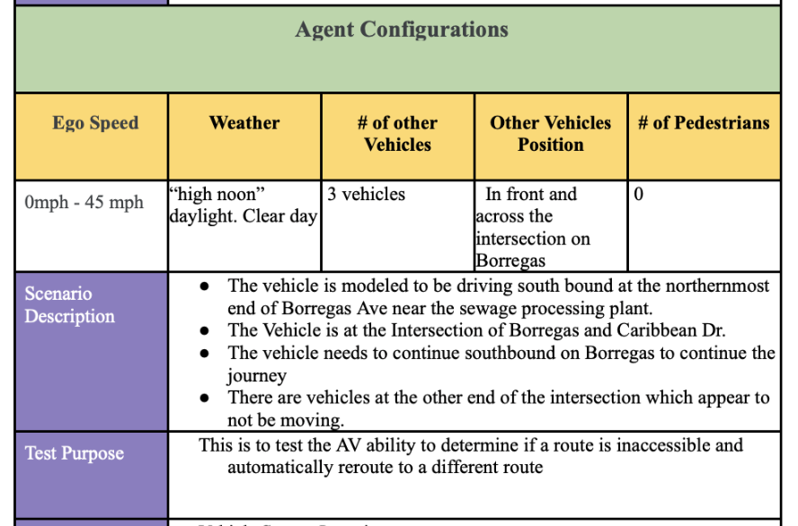
Test Scenarios #4
Encounter a blocked route
Scenario Type:
Automatic Rerouting due to traffic conditions

Slide 29
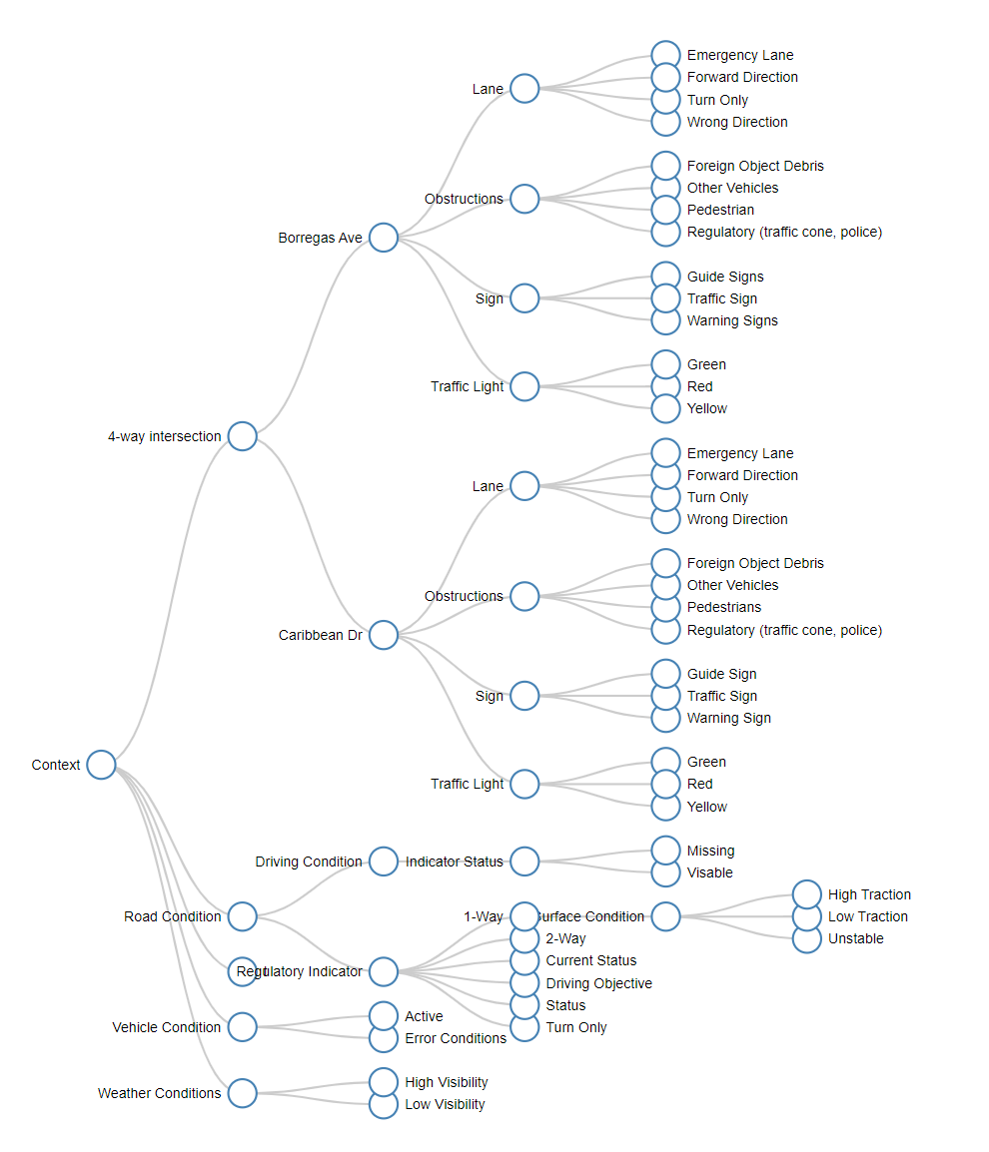
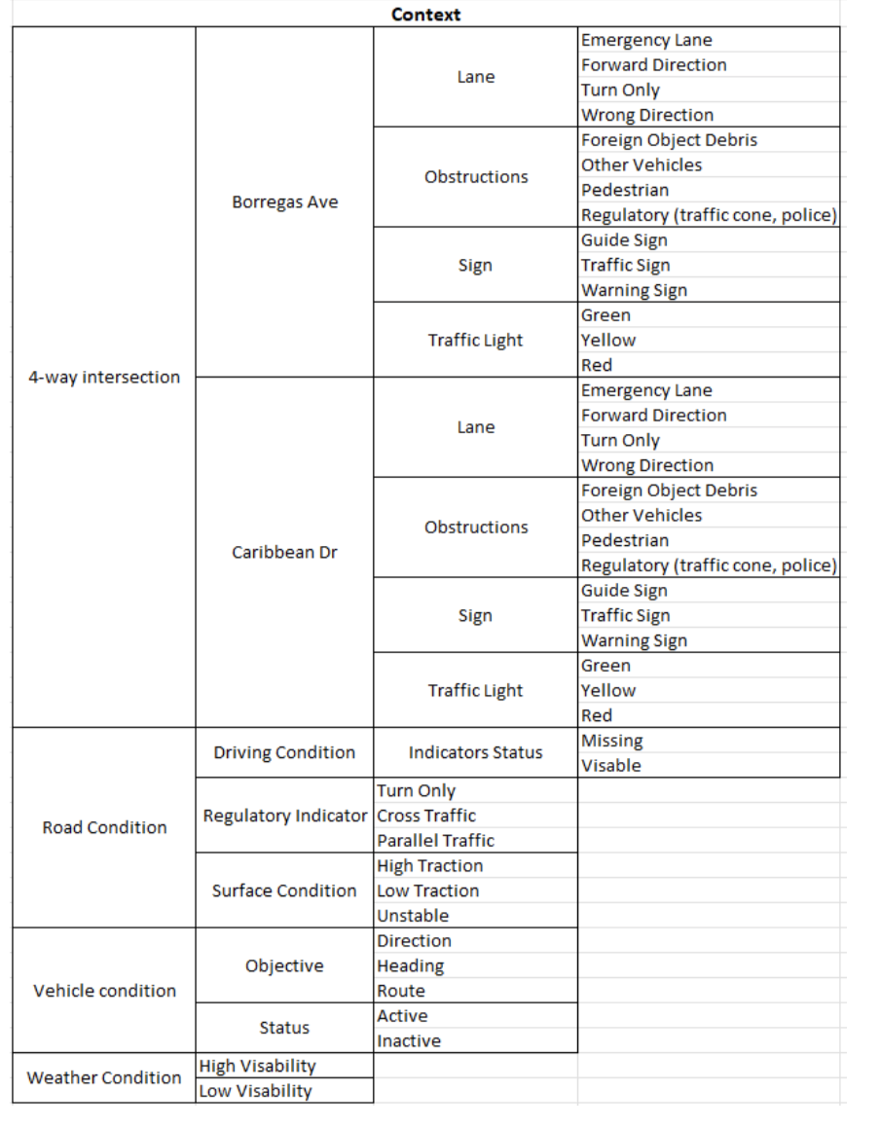
Testing Scenario #4 - Context Modeling

Slide 30
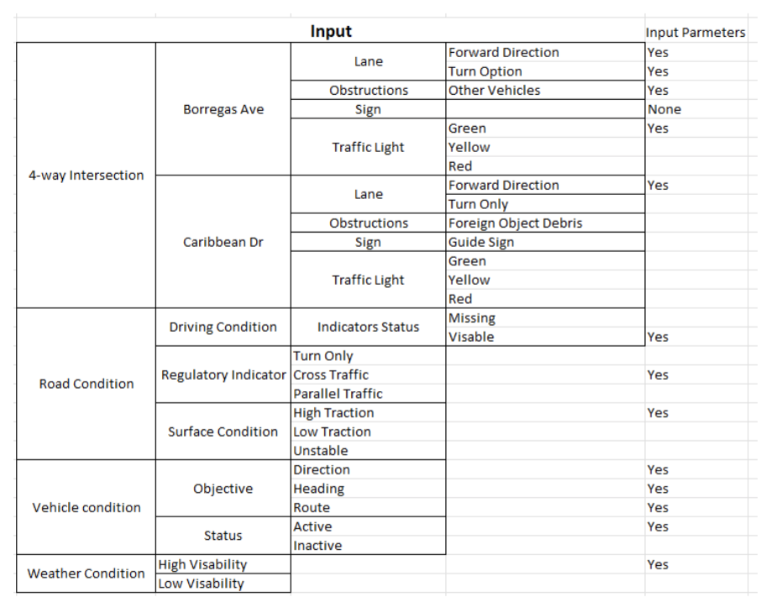
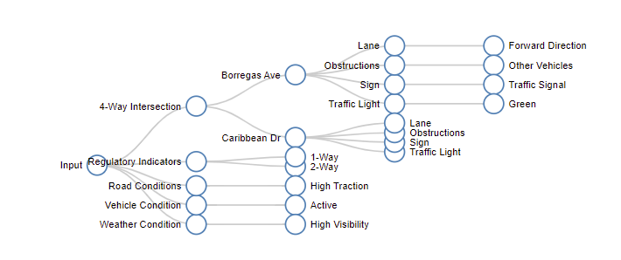
Testing Scenario #4 - Input Classification

Slide 31
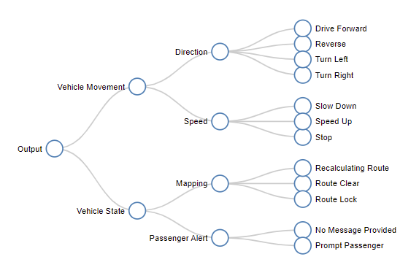
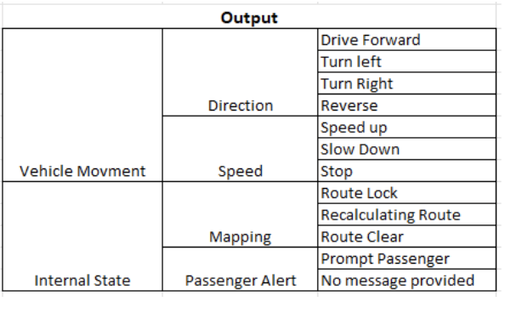
Testing Scenario #4 - Output Classification

Slide 32
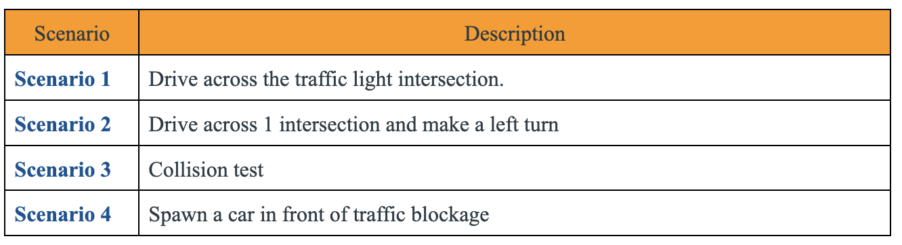
Test Scenarios
Notes:
Sudha

Slide 33
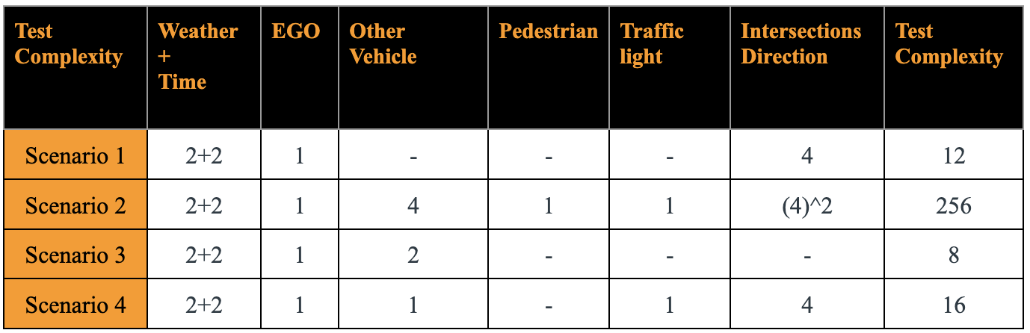
Test Case Complexity
Notes:
Sudha

Slide 34
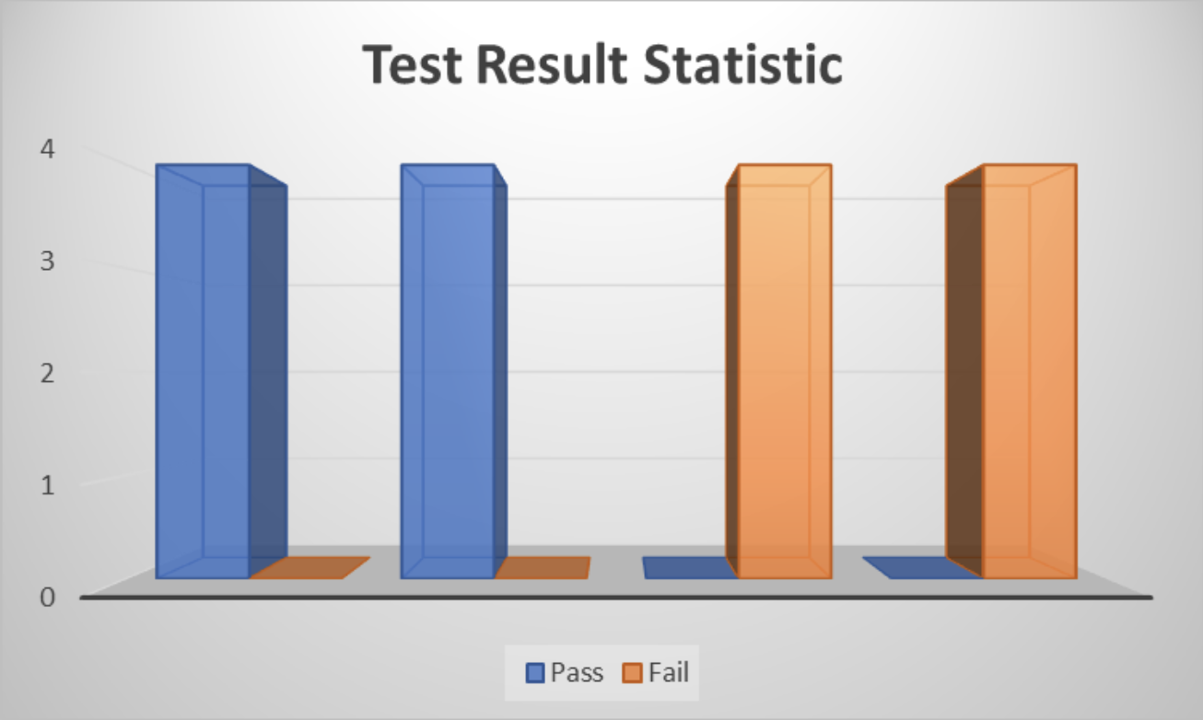
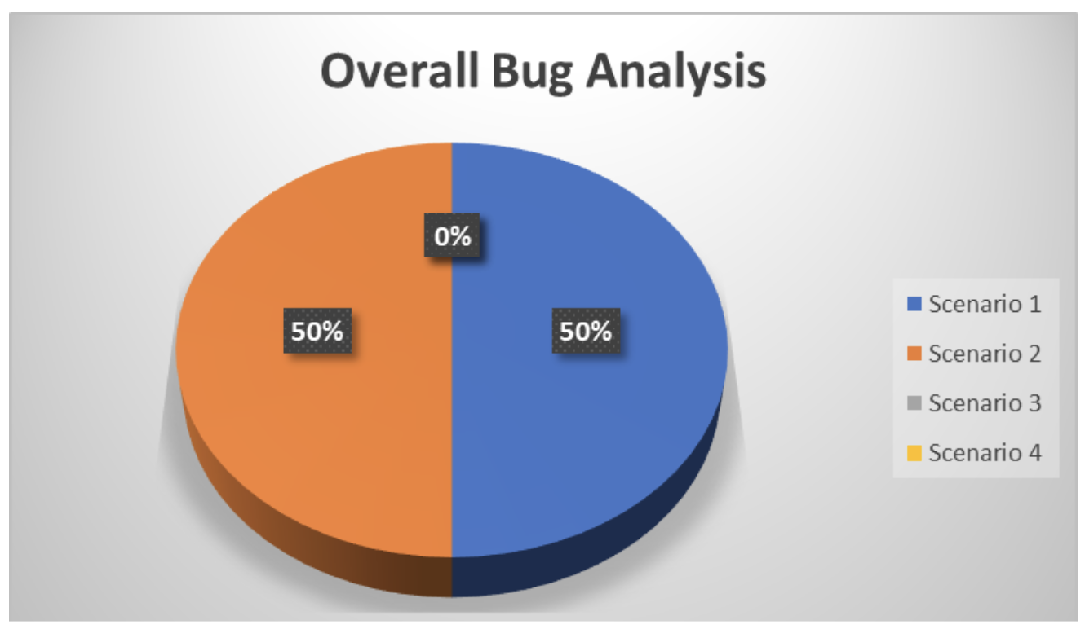
Test results
Notes:
Sudha

Slide 35
Test Scenarios #0
Agent Configurations
Ego Speed | Weather | # of other Vehicles | Other Vehicles Position | # of Pedestrians
0 mph - 45 mph | “high noon” daylight. Clear day | 0 vehicles | In front and across the intersection on Borregas | 0
Scenario Description | The vehicle is modeled to be driving south bound at the northernmost end of Borregas Ave near the sewage processing plant. The Vehicle is at the Intersection of Borregas and Caribbean Dr. The vehicle needs to continue southbound on Borregas to continue the journey and turns left on Caspian Dr.
Test Purpose | This is perform basic functionality integration test.
Drive to a Target Location
Scenario Type:
Sanity test to prove if the Simulator is functional.

Slide 36
Test Case Complexity
Notes:
Sudha

Slide 37

Base-case AV Demo
https://drive.google.com/file/d/1GvqVEoeyIFCL782iCq9sABKoyGxi-zXG/view?resourcekey

Slide 38

Full-Demo
https://drive.google.com/file/d/1GvqVEoeyIFCL782iCq9sABKoyGxi-zXG/view?resourcekey

Slide 39
Conclusion
By doing this project, we gain
Hands-on/ practical software testing, especially AV testing.
Exposure to setting up a complex AV testing environment using high power computing.
Connecting SVL simulator, Apollo 6.0 end-end to test real-life driving scenarios using Python API.
Problem-solving skill, Teamworks,Conflict management.

Slide 40
Thank you
Acknowledgement. Muslim Razi

